Slide 1
XAMANIMATION
Update 1.3

Slide 2
“Infinite animations” “Repeat the animations forever” “Delayed animations” “Layout transitions” “Parallax” “Progressive animations”
Requests

Slide 3
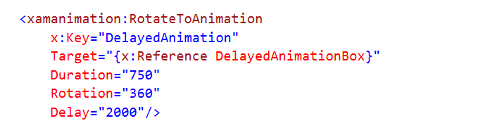
Delay Animations
Added new Delay Property (time in milliseconds).

Slide 4
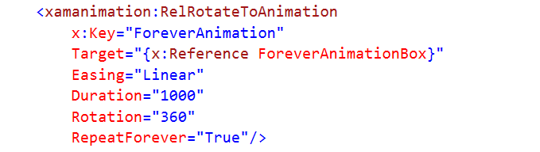
Repeat Forever
Added new RepeatForever propery.

Slide 5
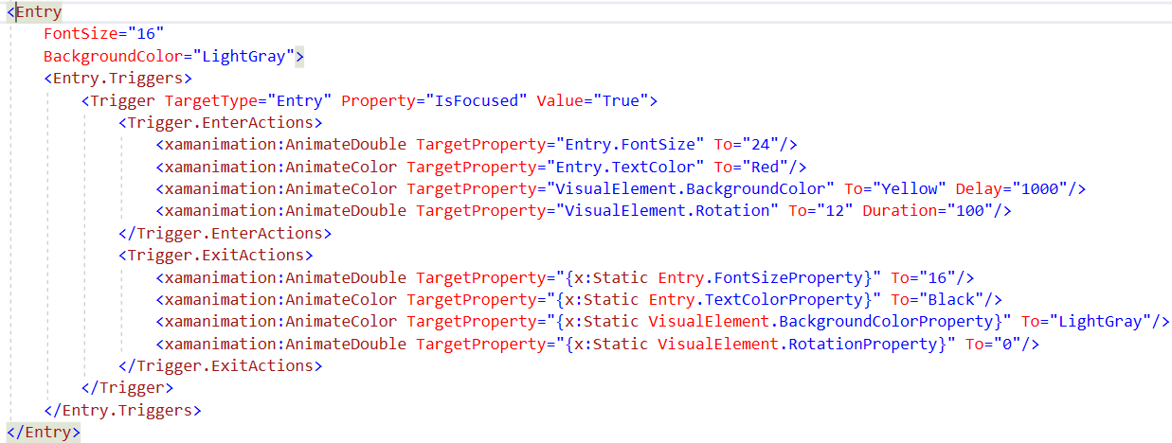
New Triggers

Slide 6
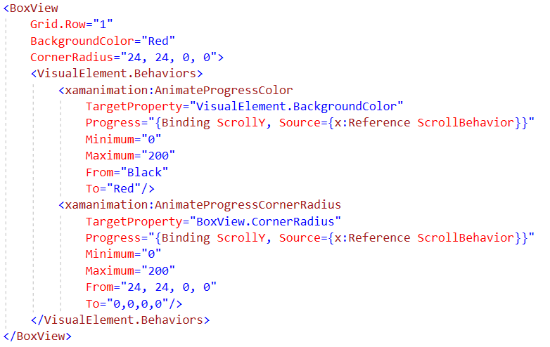
Progress Animations (ScrollView, CarouselView, etc.)

Slide 7
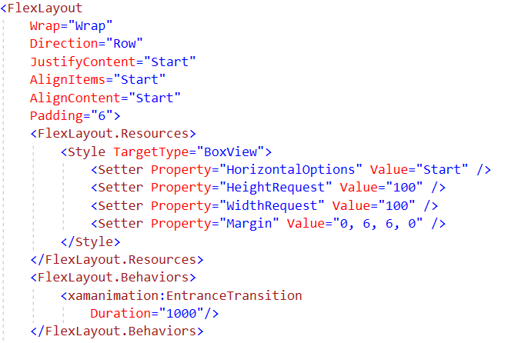
Entrance Transitions

